Slide 1
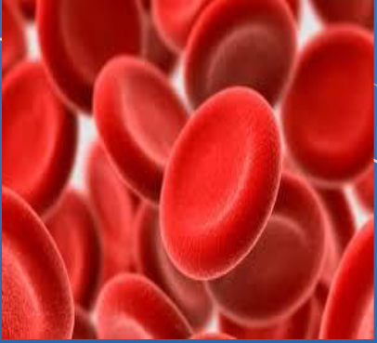
Management of Iron Deficiency Anaemia in Pregnancy

Slide 2
Management of Iron Deficiency Anemia in Pregnancy And Postpartum
Dr. Masoumeh Mirzamoradi ,MD
Obstetrician & Gynecologist , Fellowship of Perinatology
Associate professor, Shahid Beheshti university of medical sciences

Slide 3
Anemia in Pregnancy
Anemia in pregnancy is a global health problem.
An estimated 30 percent of reproductive-age females are anemic .
Among those who are pregnant, the prevalence is even higher; the WHO estimates that over 40 percent of pregnancies are complicated by anemia .

Slide 4
DEFINITION OF ANEMIA IN PREGNANCY
First trimester – Hemoglobin < 11 g/dL (approximate hematocrit <33 percent)
Second trimester – Hemoglobin < 10.5 g/dL (approximate hematocrit <32 percent)
Third trimester – Hemoglobin < 11 g/dL (approximate hematocrit <33 percent)
Postpartum – Hemoglobin < 10 g/dL (approximate hematocrit <30 percent)

Slide 5
Some individuals may have a significant decrease from baseline without crossing these thresholds, and clinical judgment is required to determine the reason for the decrease and the need for further evaluation:
For an individual with a baseline hemoglobin of 14 g/dL that decreases to 11 g/dL without macrocytosis, it is reasonable to test for iron deficiency and vitamin B12 and folate deficiencies.
For an individual with a baseline hemoglobin of 14 g/dL that decreases to 11 g/dL associated with macrocytosis, it is reasonable to check a reticulocyte count and test for vitamin B12 and folate deficiencies.

Slide 6
Acquired
Iron-deficiency anemia
Anemia caused by acute blood loss
Anemia of inflammation or malignancy
Megaloblastic anemia
Acquired hemolytic anemia
Aplastic or hypoplastic anemia
Causes of anemia during pregnancy and the puerperium
The two most common causes of anemia during pregnancy and the puerperium are iron deficiency and acute blood loss.
Iron deficiency anemia accounts for 75-95% of the cases of anemia in pregnant women.
Hereditary
Thalassemias
Sickle-cell hemoglobinopathies
Hereditary hemolytic anemias

Slide 7
Dilutional anemia
During a singleton pregnancy, maternal plasma volume gradually expands by approximately 40 -50% (1100 to 1600 cc at term)
The total RBC mass also increases but only by approximately 300 mg (15 -25%), and this starts later in pregnancy. This results in a physiologically lowered Hb, Hct, RBC count, but it has no effect on the MCV.
While some degree of dilutional anemia is part of normal pregnancy physiology, anemia can have serious adverse health consequences for the mother and child. Thus, it is critical to distinguish iron deficiency anemia from physiologic anemia, as well as to identify other less common causes of anemia that may require treatment.

Slide 8
By 6 weeks postpartum, in the absence of excessive blood loss during the puerperium, hemoglobin and hematocrit levels have returned to normal if the mother has adequate iron stores.

Slide 9
Maternal need for iron during pregnancy
In a typical singleton gestation, the maternal need for iron averages nearly 1000-1200 mg.
This quantity includes almost 350 mg associated with fetal and placental growth, about 500 mg associated with expansion in red cell mass, and around 250 mg associated with blood loss at delivery.
These amounts exceed the iron stores of most women and result in iron-deficiency anemia unless supplementation is given.

Slide 10
Prevention of iron deficiency
We provide supplemental oral iron 27 to 30 mg daily throughout pregnancy to all pregnant individuals to compensate for the increased iron demands during pregnancy; this is considered "low dose" supplementation and corresponds to the amount of iron in most iron-containing prenatal vitamins.
For those who are intolerant of the iron in prenatal vitamins, it may be possible to take prenatal vitamins without iron and to supplement with oral iron supplements on an every-other-day basis (typical dose, 60 mg once every other day or 60 mg once daily on Monday, Wednesday, and Friday).

Slide 11
Are there benefits of iron supplementation for patients who are not anemic?
Iron supplementation during pregnancy is recommended universally even in non anemic women at the first prenatal visit except in the presence of certain genetic disorders, such as hemochromatosis.
Low-dose supplementation of iron during pregnancy improves maternal hematologic parameters, reduces the likelihood of iron deficiency at term, and is not associated with harms.

Slide 12
Screening for anemia during pregnancy

Slide 13
Who should be screened for anemia during pregnancy?
All Pregnant women should be offered screening for anaemia at booking and at 28 weeks with a CBC . Women with multiple pregnancies should have an additional full blood count done at 20–24 weeks.
Who should be screened for serum ferritin during pregnancy?
While current guidelines do not recommend routine screening for iron deficiency in non-anemic pregnant individuals, data from studies using ferritin, TSAT, or both suggest that approximately 50 percent of these individuals have iron deficiency.

Slide 14
Diabetes
Smoking
HIV infection
Inflammatory bowel disease, History of abnormal uterine bleeding
Multiparas ≥3, especially those with an interpregnancy interval <6 months
BMI above or below the normal range
Vegetarian diet
Symptoms such as restless legs syndrome or pica, especially pagophagia (ice craving)
Who should be screened for serum ferritin ?

Slide 15
How to screen for iron deficiency
A ferritin level is generally sufficient for screening for iron deficiency.
It is the first laboratory test to become abnormal as iron stores decrease and it is not affected by recent iron ingestion.
However, ferritin is also an acute phase reactant that can increase independently of iron status in disorders associated with inflammation, infection, liver disease, heart failure, and malignancy .

Slide 16
Serum ferritin
Levels below 15 μg/l are diagnostic of established iron deficiency.
A level below 30 μ/l in pregnancy should prompt treatment because pregnancy can falsely elevate the reading.
Levels ≥30 ng/mL are sufficient to eliminate the possibility of iron deficiency in the majority of cases.

Slide 17
Serum ferritin
Borderline serum ferritin (30 to 40 ng/mL) can occur with active inflammation from chronic illnesses such as diabetes, or up to 100 ng/mL with chronic kidney disease or from CVD such as SLE or rheumatoid arthritis.
Thus, borderline ferritin levels should prompt testing of a full set of iron studies including , serum iron, total iron binding capacity (TIBC), and calculation of TSAT.

Slide 18
TSAT ; (TSAT = iron ÷ TIBC × 100)
Normal values are in the range of 25 to 45 percent.
Iron supplements can falsely elevate the TSAT by raising the serum iron level, an effect that peaks at approximately four hours after an oral dose.
A fasting sample or avoidance of iron supplements and iron-rich foods can obviate this problem if needed.
We consider a TSAT below 20 percent to be evidence of iron deficiency whether the ferritin level is low or normal; this practice is consistent with other sources, which cite values below 16 percent without inflammation and below 20 percent with inflammation

Slide 19
Laboratory finding in Iron deficiency anemia
CBC that shows anemia, low RBC count, low MCV < 80 , high platelet count( result from stimulation of platelet precursors by erythropoietin), Low absolute reticulocyte count.
Peripheral blood smear that shows microcytic, hypochromic RBCs .
Ferritin is below 30 ng/mL (or < 41ng/mL if anemia and comorbidities are present )
TSAT < 20%

Slide 21
Iron deficiency anemia in pregnancy
Causes and risk factors for iron deficiency

Slide 22
Decreased iron absorption
Celiac disease
Atrophic/autoimmune gastritis
Helicobacter pylori
Bariatric surgery include gastric resection, Roux-en-Y, biliopancreatic diversion
Medications that reduce gastric acidity
Nausea and vomiting of pregnancy
Blood or iron loss
Heavy menstrual bleeding
Pregnancy and lactation
Gastric ulcer disease or gastritis
Colorectal cancer
Gastrointestinal telangiectasias, HHT
Bleeding disorders such as VWD
Gastrointestinal parasites
Frequent blood donation
Surgical blood loss
Iatrogenic (frequent blood draws)
Hemodialysis

Slide 23
CLINICAL MANIFESTATIONS
Symptoms of anemia
Fatigue, Weakness, Headache
Exertional dyspnea, Exercise intolerance
Pica (pagophagia, ice craving)
Restless legs syndrome

Slide 24
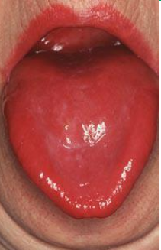
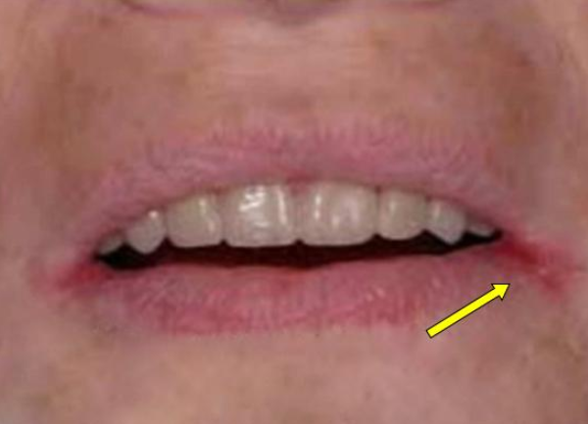
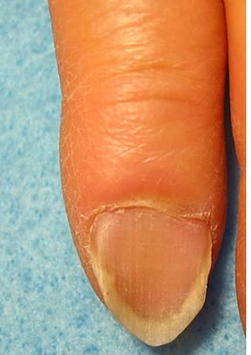
The physical examination in individuals with iron deficiency (with or without anemia):
Pallor
Dry or rough skin
Atrophic glossitis with loss of tongue papillae which may be accompanied by tongue pain or dry mouth
Cheilosis (also called angular cheilitis)
Koilonychia (spoon nails)
Atrophic glossitis
Cheilosis

Slide 25
Clinical consequences of iron deficiency anemia in pregnancy

Slide 26
Maternal anemia is associated with higher rates of intrauterine growth restriction, preterm birth, low APGAR scores, preeclampsia, and increased perinatal mortality .
Women with iron deficiency report higher rates of fatigue and are at greater risk of postpartum depression .
Iron deficiency anemia during pregnancy may increase the risk of postpartum hemorrhage .
Studies suggest that neonates born to women with iron deficiency anemia have neurocognitive deficits that may last into childhood, however larger longitudinal studies are required to confirm these findings .

Slide 27
Clinical consequences of iron deficiency anemia in pregnancy
In a Swedish study, Wiegersma et al found that iron deficiency anemia diagnosed at ≤ 30 weeks increased the risk of autism spectrum disorder, attention deficit/hyperactivity disorder, and intellectual disability in children.
Severe anemia with maternal hemoglobin levels less than 6 g/dL has been associated with abnormal fetal oxygenation, resulting in nonreassuring FHR patterns, reduced amniotic fluid volume, fetal cerebral vasodilatation, and fetal death .

Slide 28
Raised Hb
A U-shaped association has been observed between maternal Hb concentrations and birth weight.
A large observational study of 54,382 pregnancies showed higher rates of perinatal death, low birth weights and preterm delivery in women with high (Hb >13.2g/dl) compared to intermediate Hb levels, at 13-19 weeks‘ gestation (Murphy et al, 1986).
Furthermore, a booking Hb of >14.5g/dl was associated with a 42% risk of subsequent hypertension in primiparips.

Slide 29
Treatment OF IRON DEFICIENCY

Slide 30
Treatment of iron deficiency
For most individuals with iron deficiency, especially those diagnosed in the first trimester, we treat with oral iron.
Ferrous sulfate is the most commonly prescribed oral formulation.
Dosing – Recommended doses of oral iron range from 40 to 200 mg elemental iron per day .

Slide 31
Ferrous sulfate
325 mg tablet (contains 65 mg elemental iron per tablet)
220 mg/5 mL oral elixir (contains 44 mg elemental iron per 5 mL)
75 mg/mL oral solution (contains 15 mg elemental iron per Ml)

Slide 32
Treatment of iron deficiency
Absorption may be improved by avoiding coffee, tea, and milk at the time the iron supplement is taken.
To maximise absorption iron should be taken , on an empty stomach, 30-60 minutes before meals, with a source of vitamin C such as orange juice. However, when taken in this manner, dyspepsia and nausea are more common.
Other medications or antacids should not be taken at the same time.

Slide 33
Alterations in food habits that may improve iron bioavailability include:
Including fresh fruits or fruit juices and other sources of vitamin C such as tomatoes, spinach, cabbage, cauliflower, potatoes, and other green leafy vegetables in the meal.
Consuming milk, cheese, and other dairy products as between-meal snacks rather than at mealtimes AND Consuming tea or milk at those meals that are inherently low in iron such as a breakfast of a low-iron cereal.
Separating tea drinking from mealtime by at least 2 hours.

Slide 34
Adverse effects
Oral iron may be associated with gastrointestinal side effects including metallic taste, gastric irritation, nausea, diarrhea, and/or constipation.
Options to improve tolerability include extending the interval between doses, switching to a liquid that can be more easily titrated, or switching to intravenous iron (if in the second or third trimester) .
For nausea and epigastric discomfort, preparations with lower iron content should be tried.

Slide 35
Adverse effects
Changing the oral iron formulation is unlikely to be helpful as standard oral iron formulations have similar efficacy and similar rates of adverse events, with a few exceptions.

Slide 36
Choice of oral preparation
Iron absorption from the gut mucosal cells occurs via divalent metal transporter 1 (DMT1), a protein localized to the duodenum and upper jejunum.
We do not use enteric-coated or sustained-release capsules, which are poorly absorbed due to iron released too far distally in the intestinal tract; in some cases, the intact tablets are excreted in stool .

Slide 37
Intravenous (IV) iron
Weak or absent response to oral iron
low absorption due to intestinal disease (bariatric surgery ;gastric resection, Roux-en-Y, biliopancreatic diversion, IBD)
Intolerance of oral iron
lack of compliance
severe anemia, especially later in the pregnancy
Need for rapid and adequate treatment (bleeding due to placenta praevia, advanced gestational (after week 30)

Slide 38
Ferinject
Intravenous iron is not given during the first trimester but can be started after 13 to 14 weeks, as there are no safety data for first-trimester use.
Can be given as a single dose of up to 1000 mg of elemental iron.
Product labeling in the United States specifies a maximum single dose of 15 mg/kg of body weight.
Doses of FCM may be given over a 15-minute infusion.
As with all formulations, we start slowly, observe for signs of allergy or infusion reaction, and if not seen, administer the balance over 15 minutes.

Slide 39
Use of premedication
For patients with asthma or more than one drug allergy,, we routinely premedicate with 125 mg of methylprednisolone and an H2 blocker ( 10 mg of famotidine) given IV prior to administration of any IV iron product.
we are concerned that a number of adverse events attributed to IV iron are in fact due to premedications, especially diphenhydramine. Diphenhydramine may cause hypotension, somnolence, flushing, dizziness, irritability, nasal congestion, wheezing, and supraventricular tachycardia.

Slide 40
Use of premedication
For patients with a history of inflammatory arthritis, methylprednisolone, 125 mg / IV, and a short course of prednisone (1 mg/kg per day orally for four days).
We (and others) do not use H1 blockers (antihistamines) to prevent (or treat) infusion reactions.

Slide 41
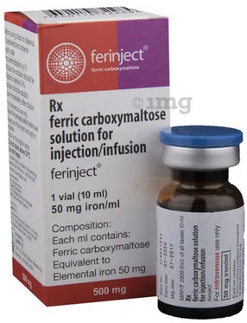
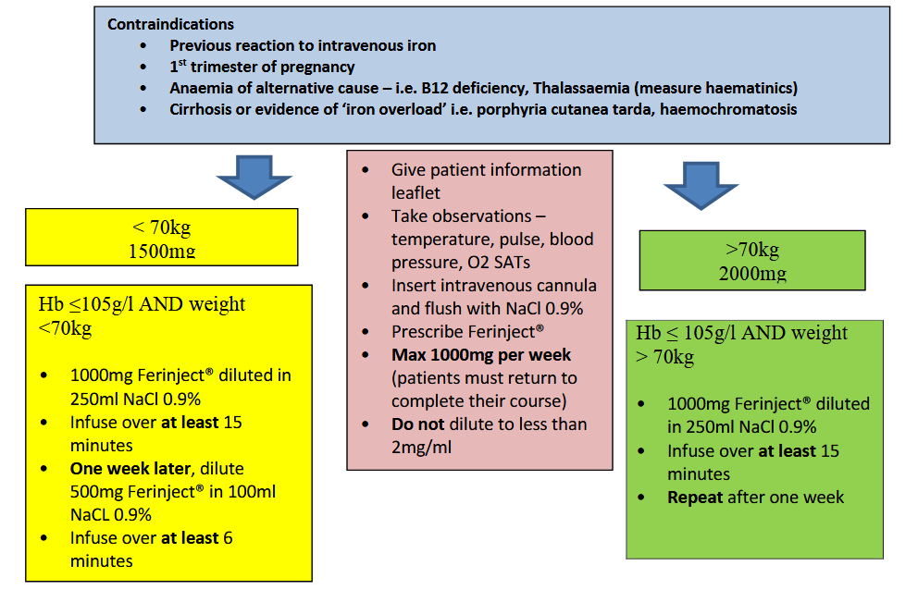

Slide 42
Drug | Concentration of elemental iron | Dosing (adults) | Test dose
Ferinject | 50 mg/mL | Weight ≥50 kg : 1 or 2 doses of 750 mg, given 7 or more days apart -OR- Weight <50 kg : 1 or 2 doses of 15 mg/kg, given 7 or more days apart | Not required

Slide 43
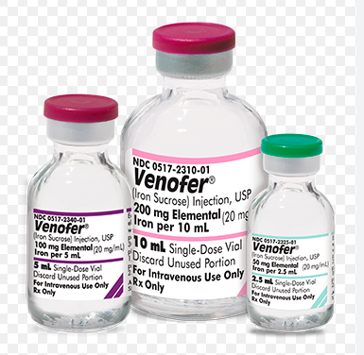
Drug | Concentration of elemental iron | Dosing (adults) | Test dose
Iron sucrose or Venofer | 20 mg/mL | Multiple doses of 100 to 300 mg | Not required, but recommended if the patient has a history of multiple drug allergies
We also avoid iron sucrose due to the administration schedule, which requires four to five separate infusions, in contrast to other formulations for which a single replacement dose can be administered in a single visit with a single infusion.

Slide 44
After the infusion:
Monitor Observations every 15 minutes
Ensure patient is monitored for 30 minutes after infusion for signs of delayed hypersensitivity
Patients should be advised not to use the oral Iron 24 hours pre infusion and 5 days post infusion.
Stop infusion immediately if:
signs of cannula leak
signs of hypersensitivity – rash, wheeze, tachycardia, falling BP < 90/40mmHg

Slide 45
ANAPHYLAXIS: (STOP infusion)
Call for senior help ( anaesthetist & obstetric )
ABC
Give IM adrenaline 0.5ml 1:1,000 and repeat if necessary
If Mild Reaction:
STOP infusion. DO NOT restart
200mg IV hydrocortisone
Discuss further management with registrar / Consultant

Slide 46
Assessing response to treatment
For antepartum patients receiving oral iron, we typically check the hemoglobin level and reticulocyte count two to three weeks after starting therapy and review tolerability of the oral iron.
The expected response to iron repletion is improvement in RBC production, which typically begins with reticulocytosis after approximately one week, an increase in the hemoglobin level of at least 1 g/dL within two to three weeks .

Slide 47
Assessing response to treatment
Once the hemoglobin has reached the normal range, oral iron replacement should continue for three months and until at least six weeks postpartum (ferritin level of roughly 50 ng/mL, and transferrin saturation of at least 30% have been obtained).
If the oral iron is not well tolerated and/or the expected increase in hemoglobin level has not occurred, options include making changes to improve tolerability (appropriate if anemia is mild) or changing to intravenous iron beginning in the second trimester.

Slide 48
Assessing response to treatment
For antepartum patients receiving intravenous iron, we generally obtain repeat iron parameters four to eight weeks after the iron has been administered.
We wait a minimum of four weeks because intravenous iron interferes with most assays of iron status. As noted in the 2019 United Kingdom Guideline, it may be reasonable to monitor an increase in hemoglobin level without rechecking iron parameters.
Once the hemoglobin has reached the normal range, oral iron replacement should continue for three months and until at least six weeks postpartum.

Slide 49
POSTPARTUM
We advise most individuals to continue their prenatal vitamin and/or supplemental iron for six to eight weeks following delivery, to increase iron stores following blood loss after delivery.
Routine testing for anemia after delivery has been suggested because anemia is prevalent and iron deficiency (the most common cause) is readily treatable. It seems reasonable that women should be iron replete following pregnancy so that they do not develop iron deficiency anemia in the future; however, high-quality data or guidelines on this subject are lacking.

Slide 50
Postnatal anemia: The WHO define postnatal anemia as Hb <10g/dl.
CBC should be checked within 48 hours of delivery in all women with an estimated blood loss greater than 500ml and in women with uncorrected anemia in the antenatal period or symptoms suggestive of postpartum anemia.
Women with Hb<10d g/l, who are haemodynamically stable, asymptomatic, or mildly symptomatic, should be offered elemental iron 100-200mg daily.
Transfusions – Used rarely for severe, symptomatic anemia.

Slide 51
Indications for referral (hematologist or gastroenterologist)
Referral to a hematologist is not indicated in the majority of patients with straightforward iron deficiency.
Referral is appropriate for those in whom iron studies are inconclusive, the diagnosis is unclear, or the administration of intravenous iron is under consideration.
Referral to a gastroenterologist is appropriate in individuals for whom an occult source of gastrointestinal blood loss or malabsorption is suspected.

Slide 53
The simplest approach to the differential diagnoses of anemia is to differentiate anemias by the mean corpuscular volume (MCV).
MCV < 80 or microcytic anemia
Iron deficiency
Thalassemia
Chronic disease
Sideroblastic anemia
Copper deficiency
Lead poisoning
MCV > 100 or macrocytic anemia
Folic acid deficiency anemia
Vitamin B-12–deficiency anemia
Drug-induced hemolytic anemia (eg, zidovudine)
Anemia associated with reticulocytosis
Anemia associated with liver disease
Anemia associated with ethanol abuse
Anemia associated with acute myelodysplastic syndrome

Slide 54
MCV 80-100 or normocytic anemia etiologies are as follows:
Hemorrhagic anemia
Early iron deficiency anemia
Anemia of chronic disease
Anemia associated with bone marrow suppression
Anemia associated with chronic renal insufficiency
Anemia associated with endocrine dysfunction
Autoimmune hemolytic anemia
Anemia associated with hypothyroidism or hypopituitarism
Hereditary spherocytosis
Hemolytic anemia associated with paroxysmal nocturnal hemoglobinuria

